Slide 1

Two Unique Approaches to Bring Products to Market While Building a Brand
Presented by:
Chris & Philip

Slide 2


A Glimpse Inside
Where creativity comes to life.

Slide 3
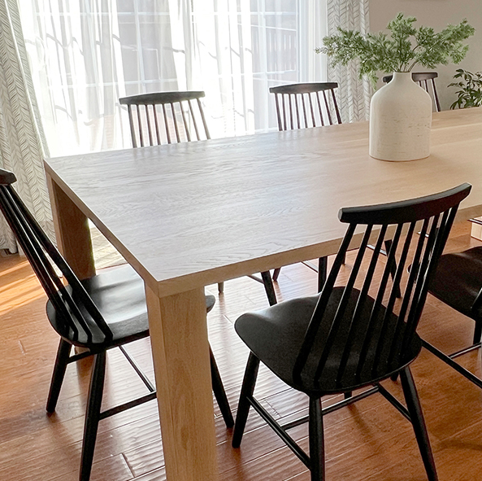

Philip Miller Furniture
Making the impossible joint possible.

Slide 4

Design products that solve problems and live beyond trends.
The difference between projects that sell versus designing products that earn a living and can build a brand to launch a new career.

Slide 5
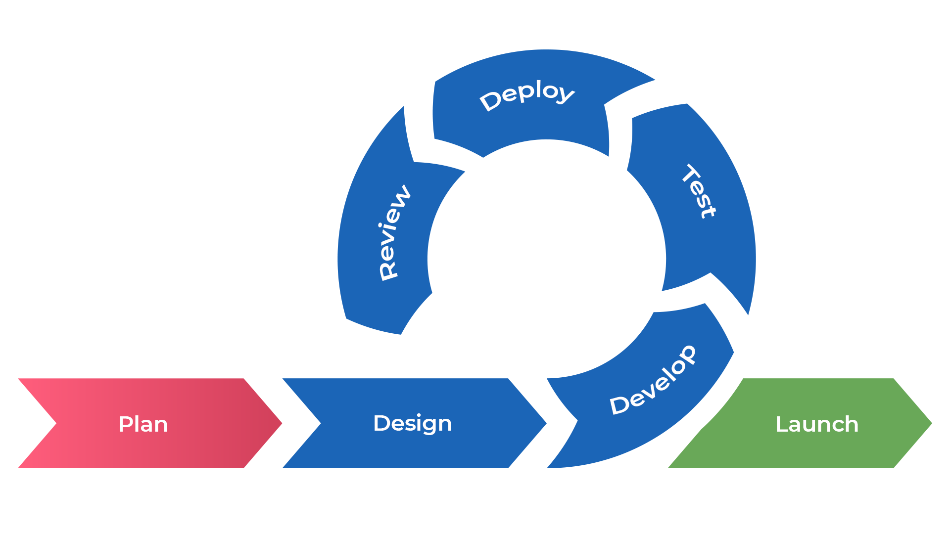
Prototype
Don’t be afraid to prototype your idea and iterate on it.

Slide 6
Challenges of Scale
“You can build anything once, that is easy. Scale is 1,000 times harder.” – Philip
“Making things is not as intimidating as one might think.” – Chris

Slide 7

Protect your idea
Be the first to market
Patent Your Idea
Utility – Protects the process of “how it’s made” or “how it works”
Design – Protects the unique appearance (non-functional aspects)

Slide 8
Take Aways
A Glimpse Inside & Philip Miller Furniture
Try every idea. You never know what spaghetti is going to stick to the wall when you throw it
Look for problems to solve; not every idea will work or scale
Develop an agile mindset. Focusing on the customer, rapid experimentation, continuous improvement, minimizing waste, & working with other teams
Communication and documentation is key to success

Slide 9
Resources
Prototyping & Manufacturing
Wagner Machine Co.
wagner-machine.com
Phone | 217-384-0072
Titan Metals Inc.
titanmetalsinc.com
Phone | 630-752-9700
Southeast Tool
southeasttool.com
Phone | 877-465-7012
PFC
pfccases.com
203-397-1338
Patent
Craig & Craig LLC
craiglaw.net
Phone | 217-234-6481
Photography & Web
Prisma
madebyprisma.com
contact@madebyprisma.com

